Slide 1




5
Power BI
QUICK START
Prepared By :
Said Fawzy
Manager of Information Center
Tendering Department
Arab Contractors

Slide 2

Module 5
Report Design

Slide 3
01
Report Editor
02
Bar and Column Chart
Module Contents
03
Pie and Donut Charts
Line Chart
04

Slide 4
05
Table Visualization
06
Themes
Module Contents
07
Treemaps
Cards
08

Slide 5
09
Page Navigator
10
Filtering Context
Module Contents
11
Slicers
Cross Filtering and Cross Highlighting
12

Slide 6
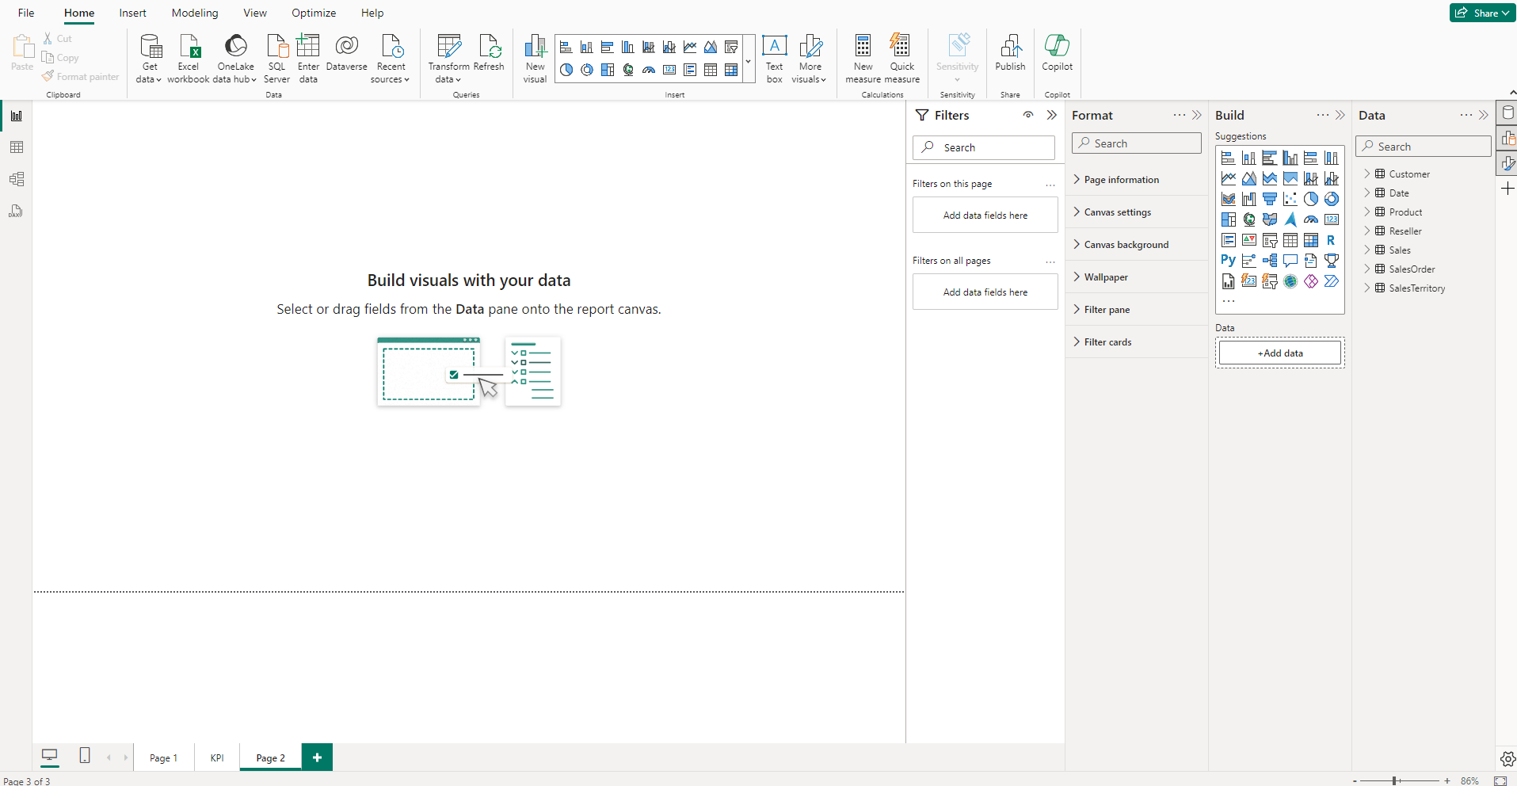
Report Editor
This is where you'll spend most of your time converting raw data into meaningful visual stories.

Slide 7
Report Editor
Ribbon
The Ribbon is where you have all your high-level command options

Slide 8
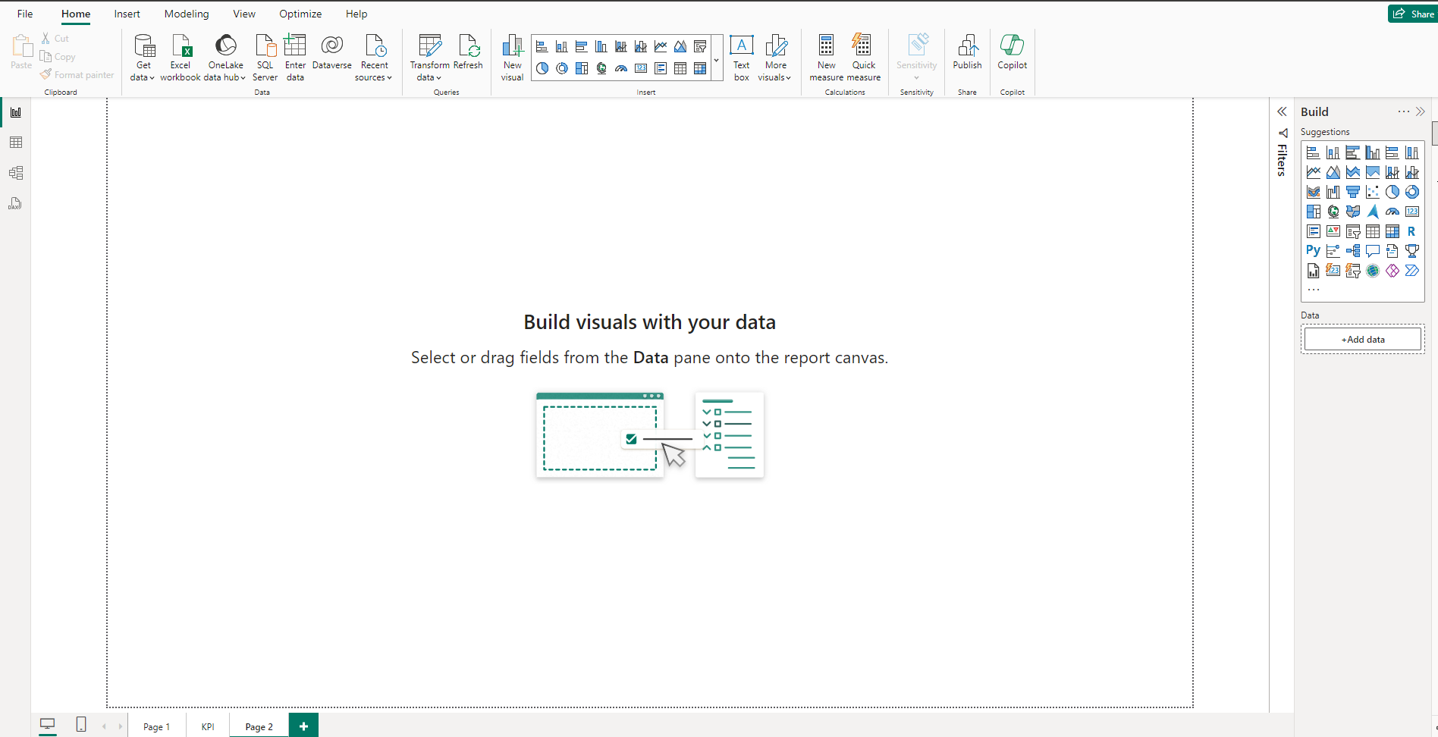
Report Editor
Report Canvas
The Report Canvas is your stage; this is where your performance happens.
All the dragging and dropping of fields and visuals you do end up here.

Slide 9
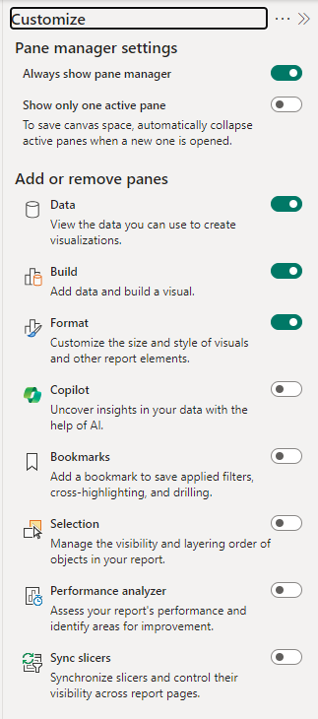
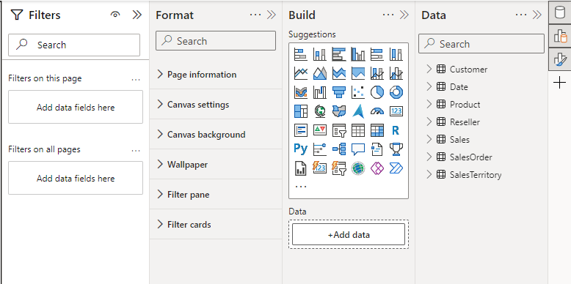
Report Editor
Report Editor panes

Slide 10
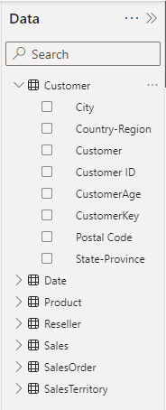
Report Editor
Data pane
When you load data into Power BI, those data fields appear in the Data pane on the right-hand side of your screen.

Slide 11
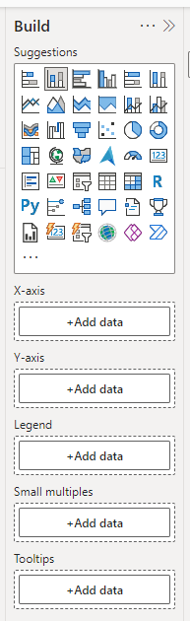
Report Editor
Build pane
Is where you choose your visual and add fields to build.

Slide 12
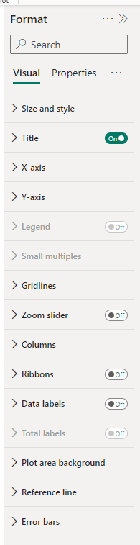
Report Editor
Format pane
It is where you format your visuals and set properties.

Slide 13
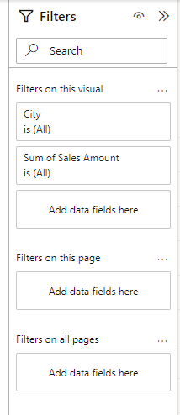
Report Editor
Filter pane
It is where you can filter your Visual , Page or entire report to get specific data.

Slide 14
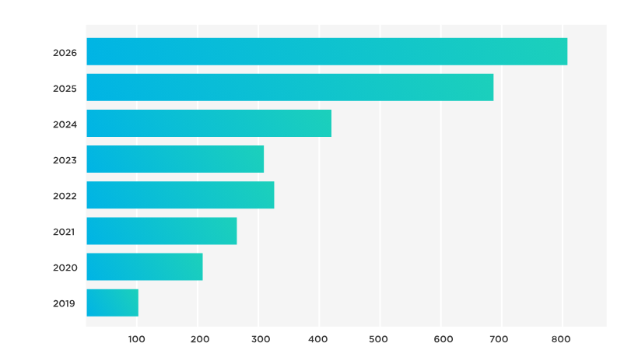
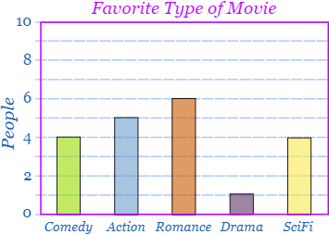
Bar and Column Charts
Bar and column charts are popular types of visualizations to display data in a clear and organized way.
They are beneficial for showcasing categorical data or data that can be organized into distinct groups.

Slide 15
Bar and Column Charts
Bar charts display data horizontally, whereas column charts display data vertically.

Slide 16
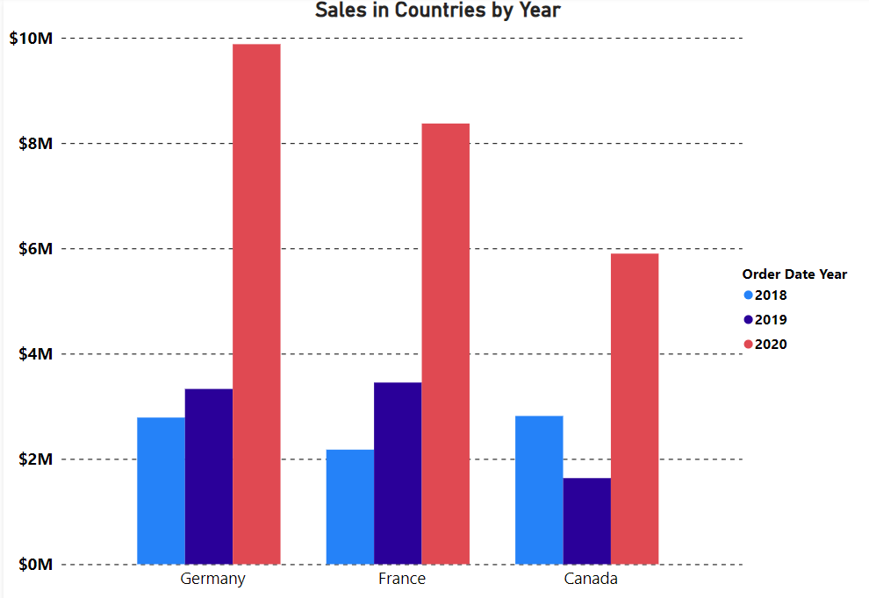
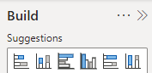
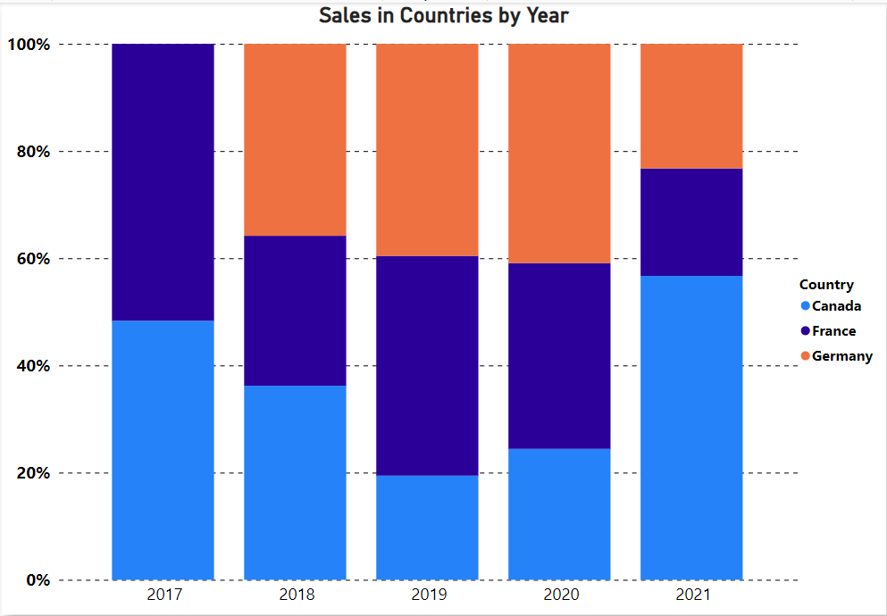
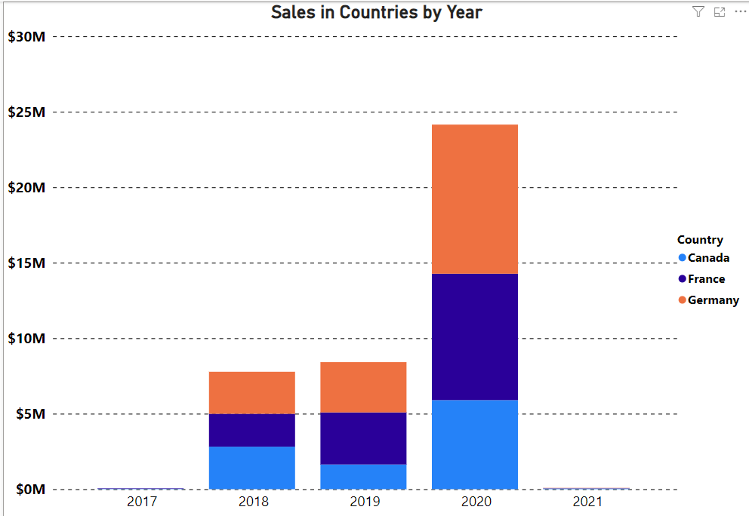
6 Types of Bar and Column Charts
Clustered
Stacked
100% Stacked

Slide 17
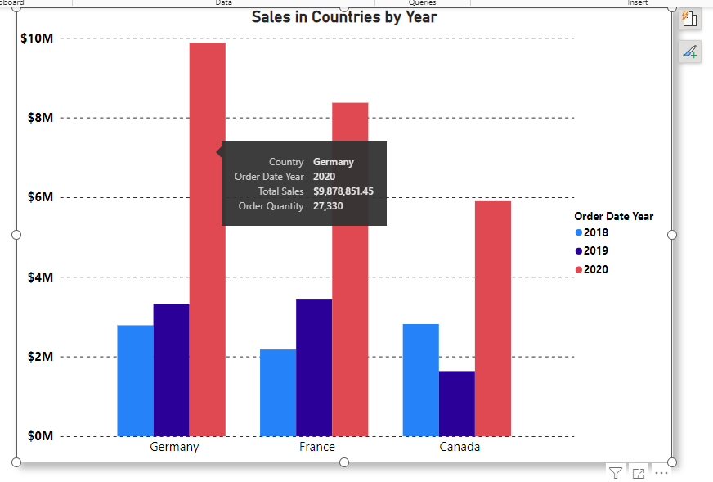
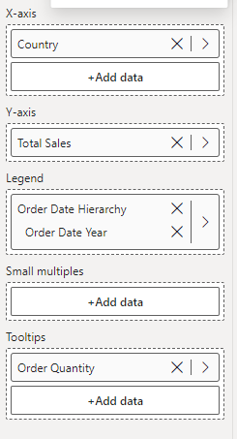
4 essential field wells in Column and Bar Charts

Slide 18


Exercise 12
Creating Column Chart

Slide 19
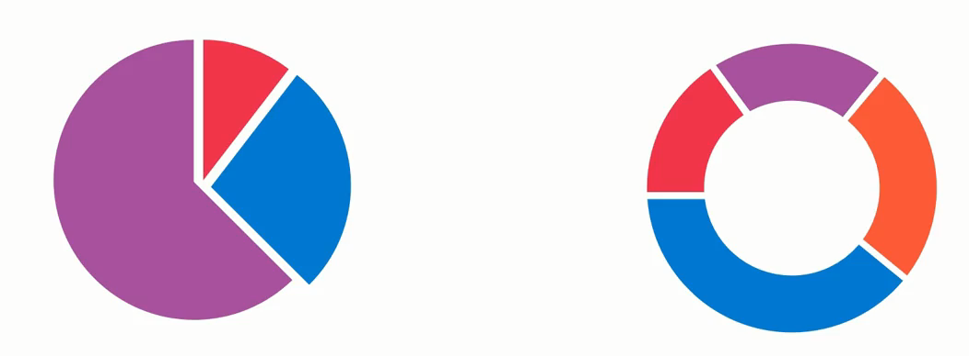
Pie and Donut Charts

Slide 20
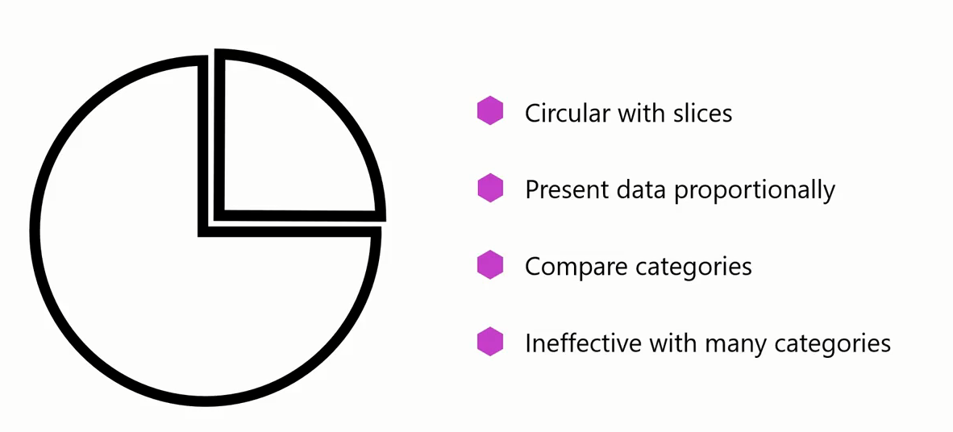
Pie and Donut Charts

Slide 21
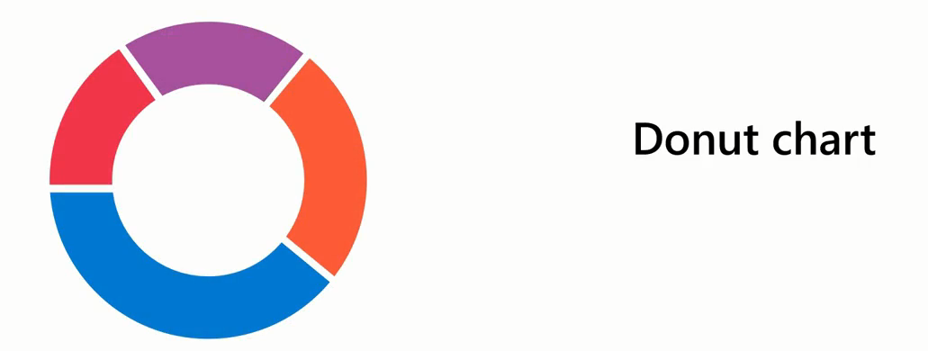
Pie and Donut Charts
The difference between a pie and a donut chart is that the donut chart is ring-shaped with a circular central space.
You can use this space to provide context for the surrounding segments.

Slide 22
Exercise 13
Creating Pie and Donut Chart

Slide 23
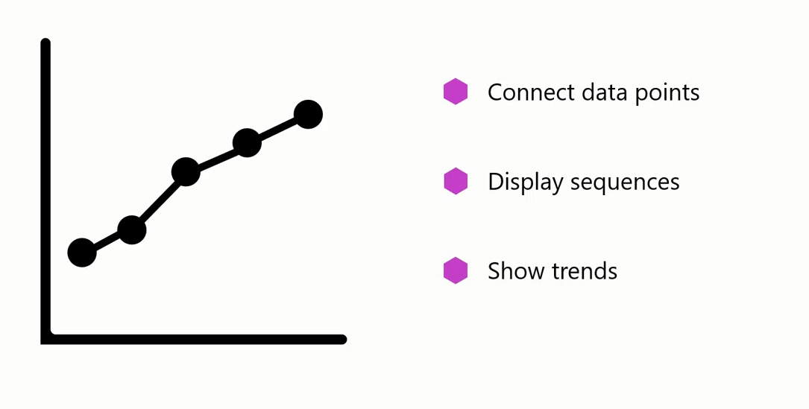
Line Chart

Slide 24
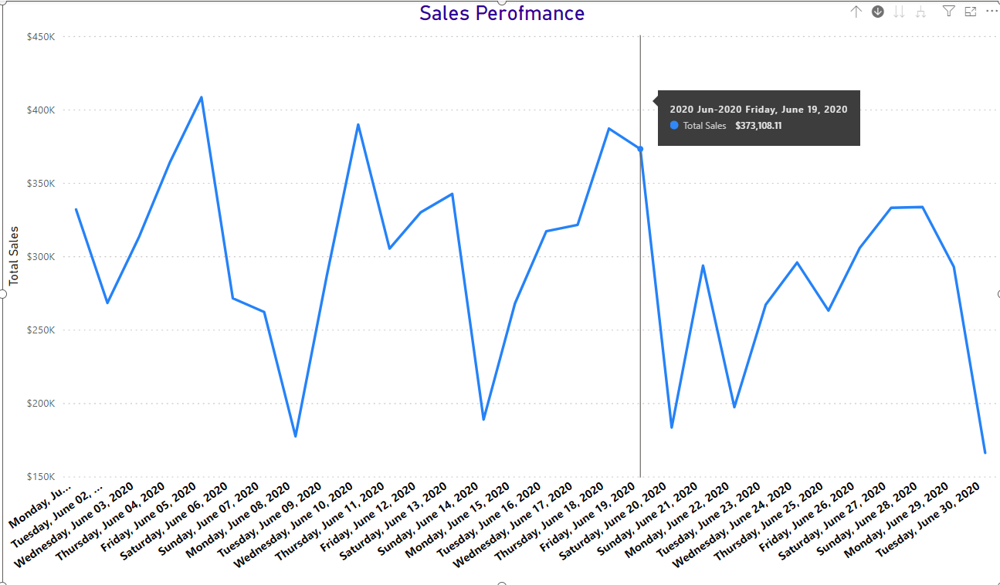
Line Chart
A line chart can help company understand how sales are progressing month to month or year to year.

Slide 25
Exercise 14
Creating Line Chart

Slide 26
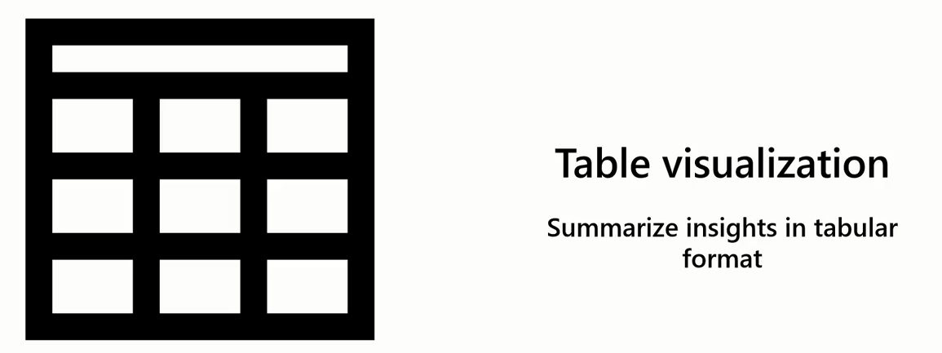
Table Visualization
Table visualization is useful when you want to employ the classic clear-cut style of tables to ensure your audience can grasp the essence of the data quickly.

Slide 27
Exercise 15
Creating Table Visualization

Slide 28

Themes
Your report should always align with the company's brand, colors, and style guide.
To update the design elements of the report to reflect the company's brand aesthetics would be a tedious, time-consuming task.
Luckily, themes in Microsoft Power BI could simplify the task at hand and save you a lot of time and effort.

Slide 29
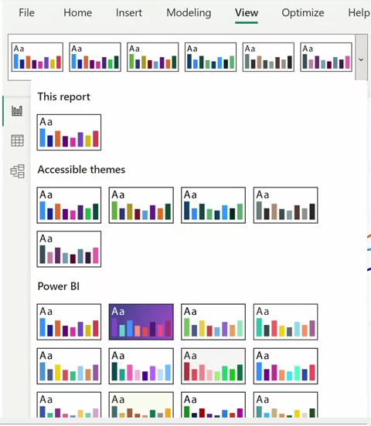
Themes
Themes in Power BI are predefined sets of colors, fonts, and visual styles that you can apply to your reports easily and quickly

Slide 30
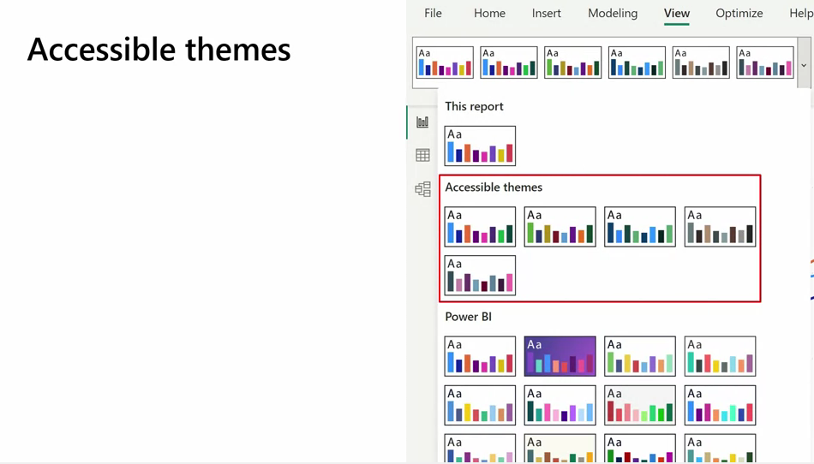
Themes

Slide 31
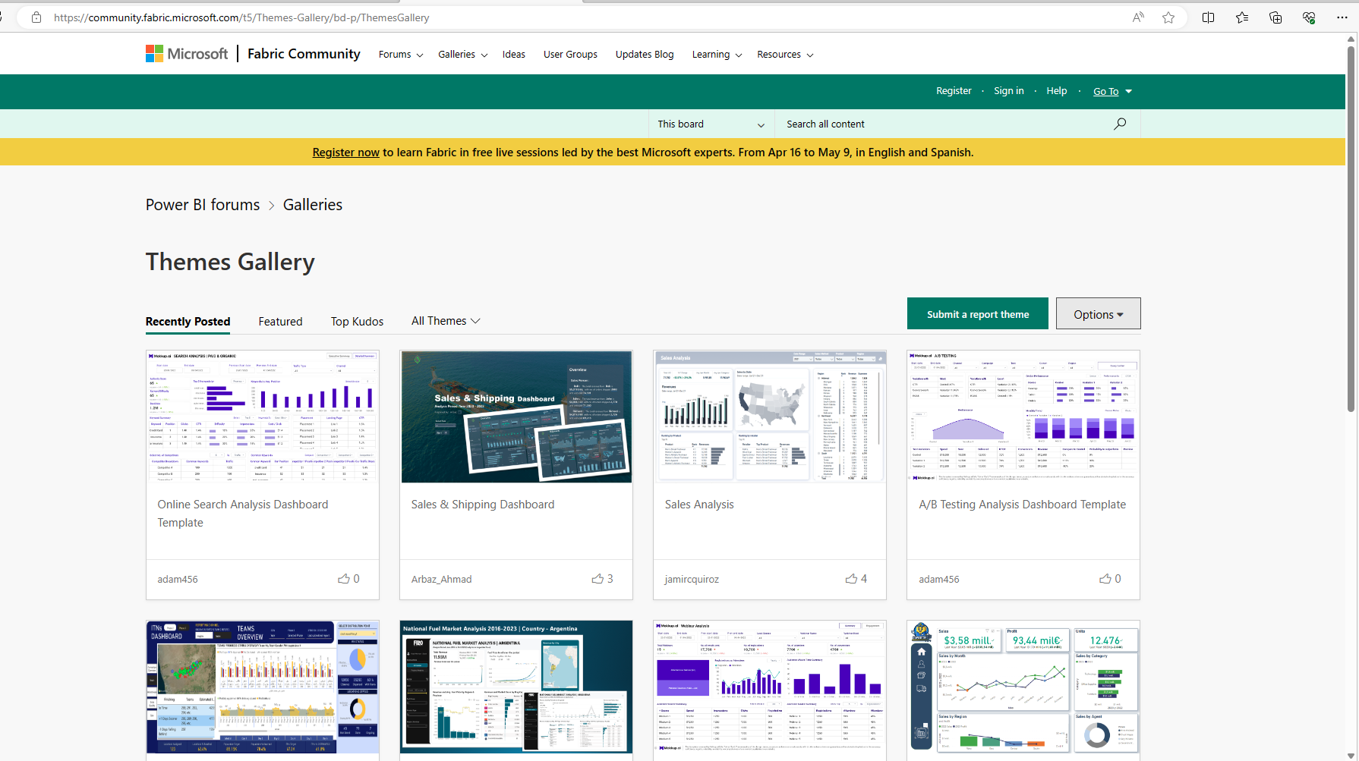
Theme Gallery

Slide 32
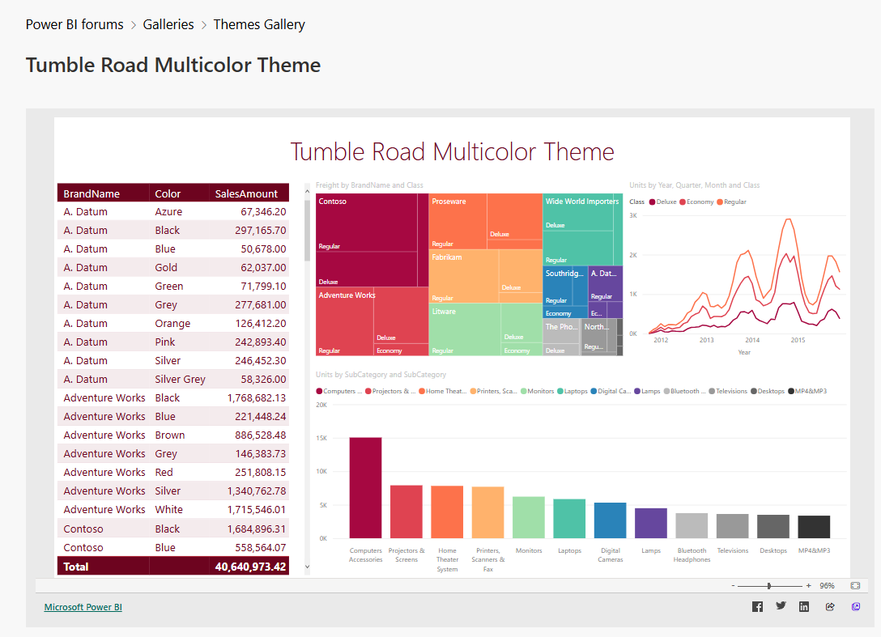
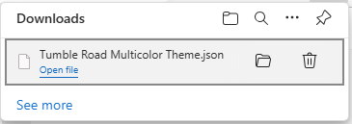
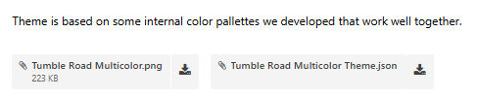
Theme Gallery

Slide 33
Exercise 16
Working with themes

Slide 34
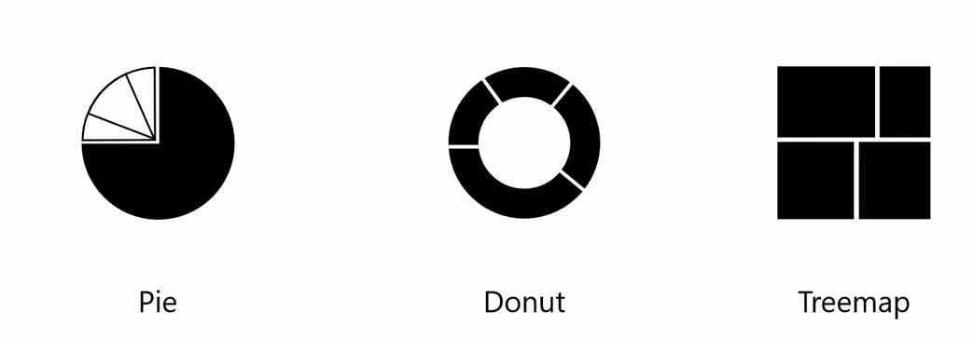
Treemaps
Treemaps are another helpful tool for illustrating your proportional data

Slide 35

Treemaps
The entire chart represents the total dataset or tree.
Each rectangle or branch represents a portion of the whole tree

Slide 36
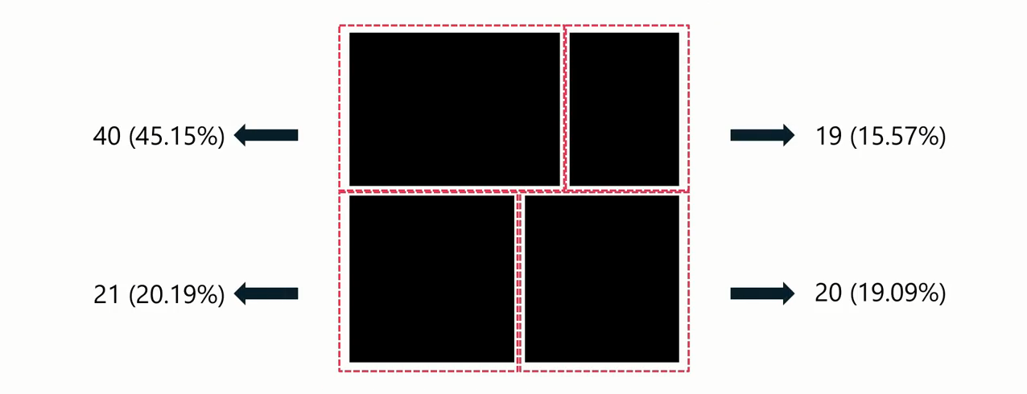
Treemaps

Slide 37
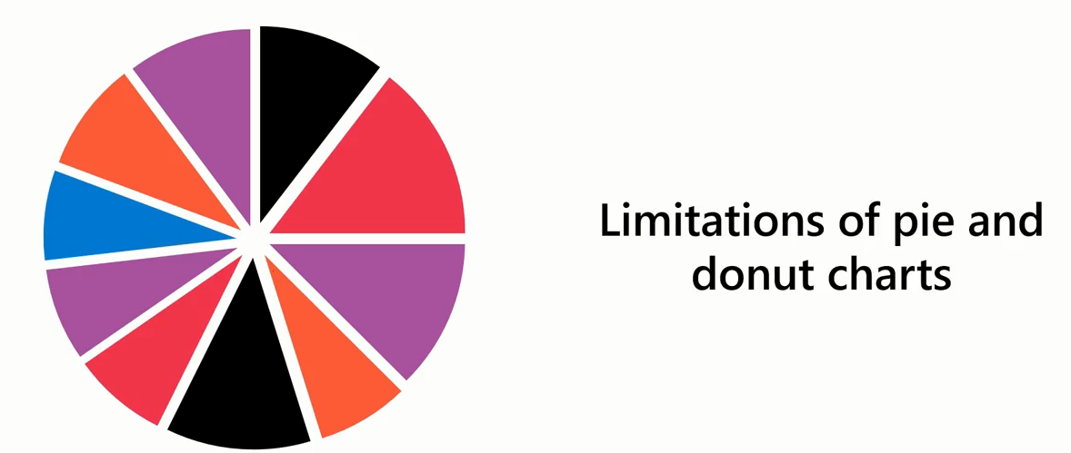
Treemaps
Pie and donut charts can become cluttered and difficult to read when dealing with:
Many categories of variables, or
When the differences between data points are small.

Slide 38
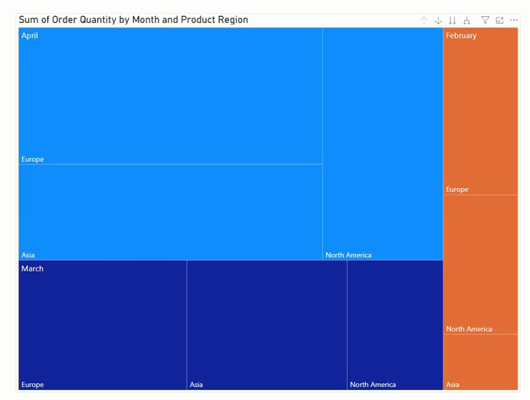
Treemaps
Example

Slide 39
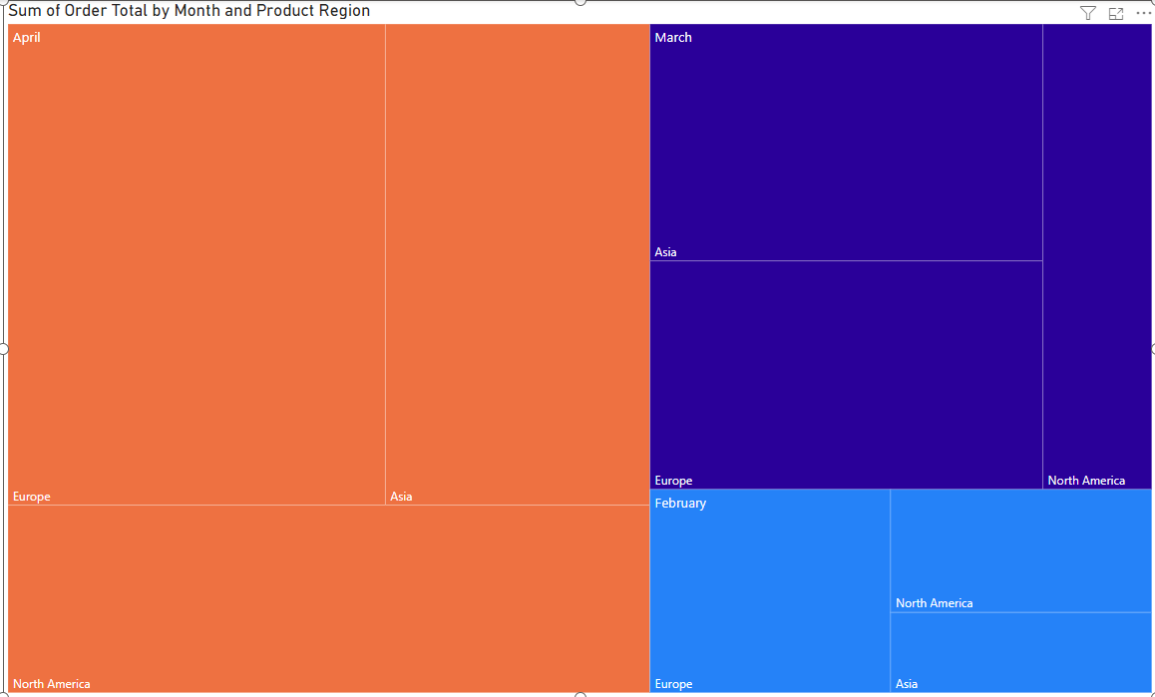
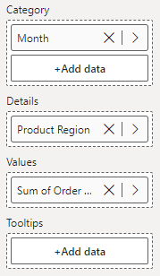
Treemaps

Slide 40
Exercise 17
Create Treemap

Slide 41
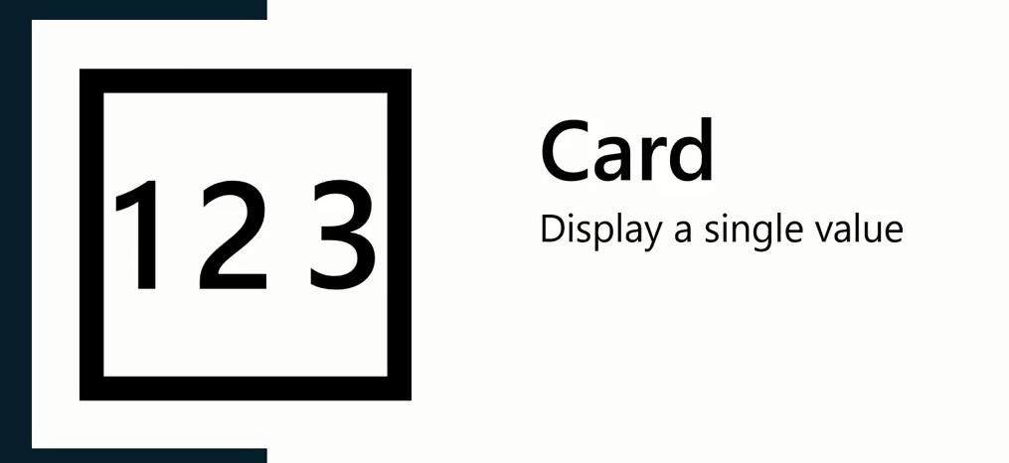
Card Visual

Slide 42
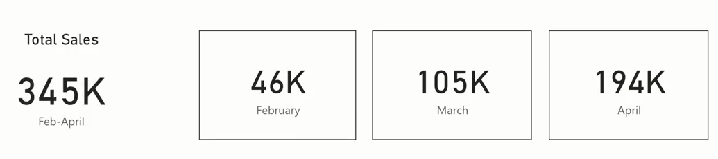
Card Visual

Slide 43
Exercise 18
Creating Card Visual Charts

Slide 44
Exercise 19
Create Page Navigators

Slide 45
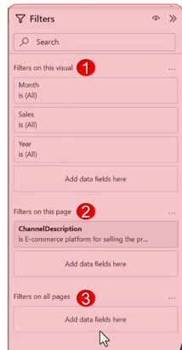
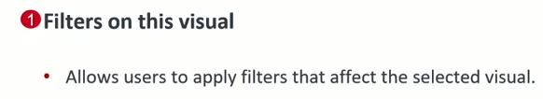
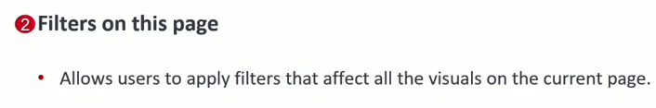
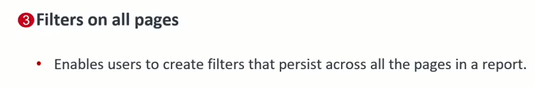
Filter Pane

Slide 46
Exercise 20
Filtering Context

Slide 47

Slicers
A slicer is a great way to apply common filters to a report page quickly

Slide 48
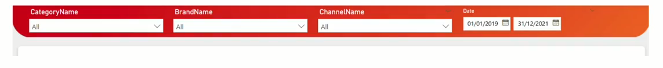
Slicers

Slide 49

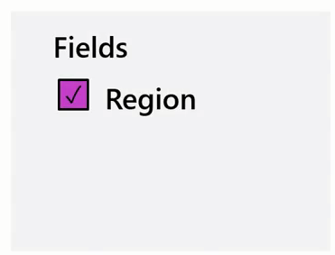
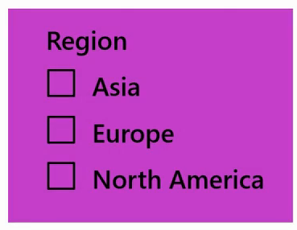
Slicers
The slicer can be displayed in multiple formats depending on the field on which the slicer is filtering.

Slide 50

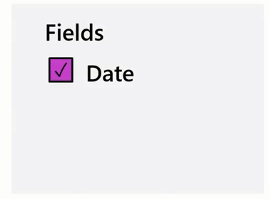
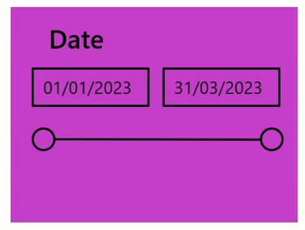
Slicers
The slicer can be displayed in multiple formats depending on the field on which the slicer is filtering.

Slide 51
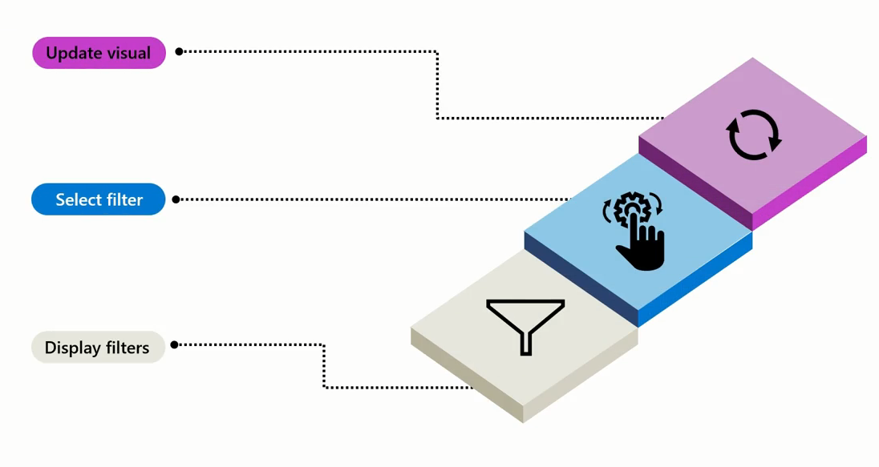
Slicers

Slide 52
Exercise 21
Creating Slicers

Slide 53
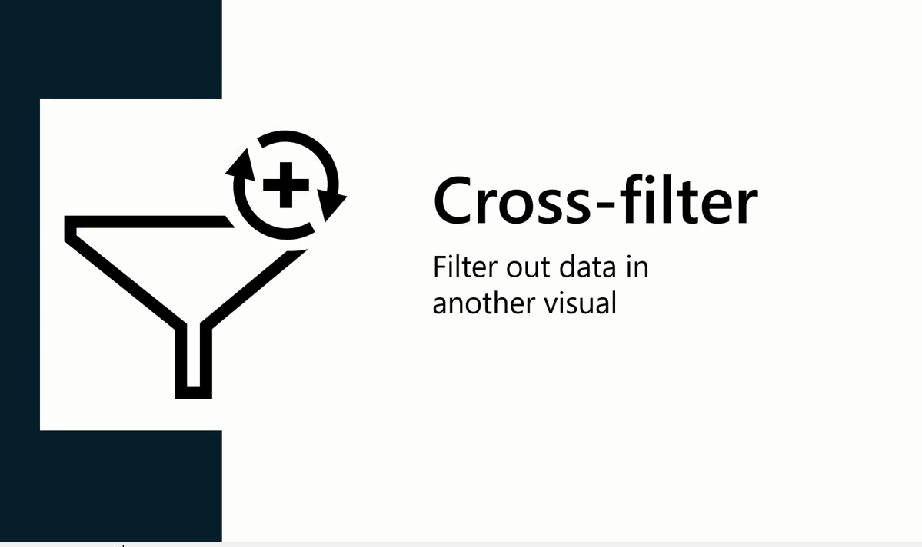
Cross-Filter and Cross-Highlight

Slide 54
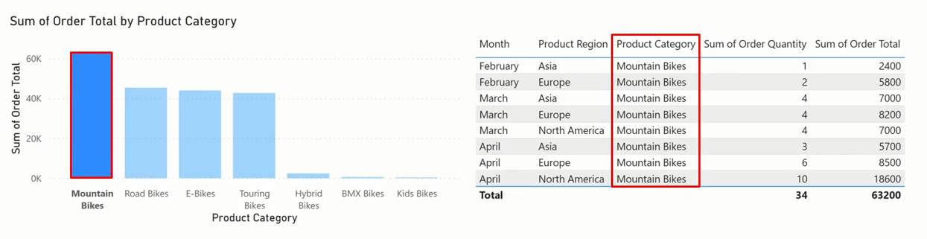
Cross-Filter and Cross-Highlight

Slide 55

Cross-Filter and Cross-Highlight

Slide 56
Cross-Filter and Cross-Highlight
Default behavior in Power BI

Slide 57
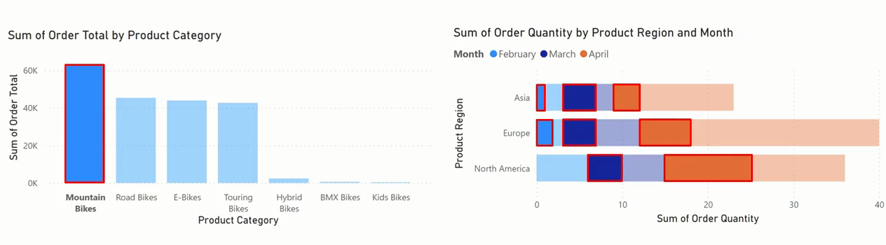
Cross-Filter and Cross-Highlight

Slide 58
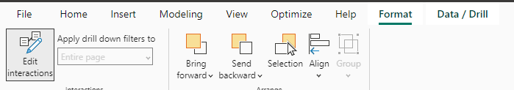


Cross-Filter and Cross-Highlight
Filter Highlight Non
Change Behavior Individually

Slide 59
Exercise 22
Cross-Filter and Cross-Highlight

Slide 60



